Slide 1


Front end
(Html)
Lecture-6

Slide 2
Today’s Agenda
Creating Tables In Html
Attributes Of Table
Generating Irregular Tables

Slide 3
Tables In HTML
A table is a structured set of data made up of rows and columns.
Tables allows us to quickly and easily look up values that indicate some kind of connection between different types of data
For example , the table shown on next slide.

Slide 4
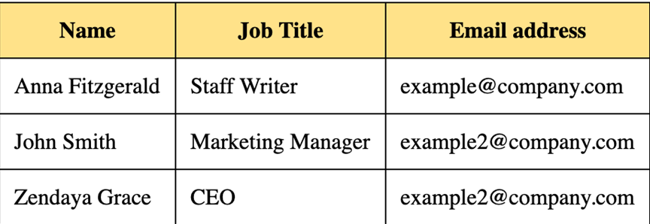
Tables In HTML

Slide 5
How To Create Table ?
To create a table we use <table> tag , which itself has 3 important child tags as shown below:
<table>
Used as Container tag
<tr>
Used to generate row
<td>
Used to generate column
<th>
Used to generate column heading

Slide 6
General Syntax
<table >
<tr>
<td> some data</td>
<td>some data</td>
</tr>
<tr>
<td>some data</td>
<td>some data</td>
</tr>
</table>

Slide 7
Creating Header Cells
Two types of cells can be defined in an HTML table. One of them is the simple cell , created using <td> tag.
The other one is a special type of cell created using <th> element, that contains header information for a set of specified cells.
Browsers render the content of header cells in a special way ,as centered bold text

Slide 8
Various Attribute Of <table> Tag
The <table> tag has following important attributes:
border
Sets the border width in numerical values from 0 and up.
cellspacing
Empty space between table data cells.
cellpadding
Empty space between the edge of a cell and cell content.

Slide 9
Various Attribute Of <table> Tag
align
Aligns the table to the left, right or center.
width/height
The width/height of the table; measured in pixels or percentage.
bgcolor
Background color for all cells that do not have a background color or image specified.

Slide 10
Various Attribute Of <table> Tag
background
Background image for all cells that do not have a background color or image specified.
bordercolor
Border color for the table.

Slide 11
Attributes Of <tr> Tag
1.bgcolor
This attribute is like the one set in the table only it will define the background color for the row only and not the entire table.
<tr bgcolor=“#00FF00">

Slide 12
Attributes Of <tr> Tag
2. align
The align attribute for the table row is different from the table align attribute, this aligns the content in the row with respect to the table. The values are: left, right and center. The default. Left
<tr align=“right">
3. valign
This is the vertical alignment attribute. It defines the vertical alignment of the content within the row. The values for this attribute are: top, middle, bottom. The default setting is middle.
<tr valign=“bottom">

Slide 13
Attributes Of <td> Tag
bgcolor Just like the bgcolor attribute in the tr tag, this attribute works the same. It will define a background color for each cell. <td bgcolor="#0000FF">

Slide 14
Attributes Of <td> Tag
2. align
This attribute also works the same as in the tr tag, it will align the content in within each cell. The values are: left, right, and center. The default is Left .
<td align="center">

Slide 15
Attributes Of <td> Tag
3. valign
This attribute also works the same as in the tr tag, it vertically aligns the content within the cell. The values are: top, middle, bottom. The default is middle.
<td valign=“top”>

Slide 16
What Are <thead>,<tbody> and <tfoot> ?
HTML 5 introduced 3 new tags called <thead>, <tbody> and <tfoot>.
All these three tags are used to provide rich information to browser, search engines , and assistive technologies about the meaning of the content found in each part of an HTML table

Slide 17
What Are <thead>,<tbody> and <tfoot> ?
thead is used to enclose a group of rows in a table as a header.
tfoot is used to enclose a group of rows in a table as a footer, such as last row for summary.
tbody is for main body of the table.

Slide 18
What Is caption ?
The <caption> tag defines a table caption.
The <caption> tag must be inserted immediately after the <table> tag and before <thead> tag.

Slide 19
Using “colspan” And “rowspan” Attributes
Table cells can span across more than one column or row.
The attributes colspan ("how many across") and rowspan ("how many down") indicate how many columns or rows a cell should take up.

Slide 20
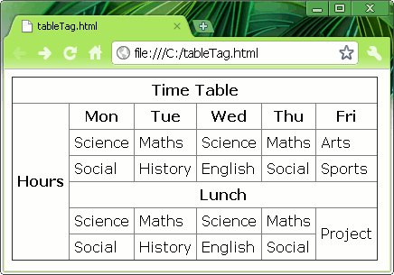
Sample Table

Slide 21
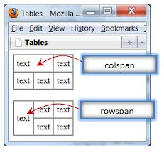
“colspan” And “rowspan”

Slide 22
“colspan” Syntax
<table >
<tr>
<td> some data</td>
<td>some data</td>
</tr>
<tr>
<td colspan=“2”>some data</td>
</tr>
</table>

Slide 23
“rowspan” Syntax
<table >
<tr>
<td rowspan=“2”> some data</td>
<td>some data</td>
</tr>
<tr>
<td >some data</td>
</tr>
</table>

Slide 24
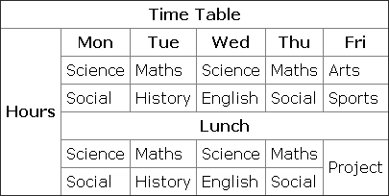
EXERCISE

Slide 25

End Of Lecture
For any queries mail us @: scalive4u@gmail.com
Call us @ : 0755-4271659, 9826686245
Agenda for Next Lecture:
Using HTML forms
Working with various form controls

